Slide 1
Website structure
How to get start
Name: UPABT001920-WebsiteStructure-Rev1-MTY-200121
Revision: Rev 1.0
Date: 2020-01-21
Author: Martin Tilly
UNIK Template: Website Structure UPABT001920 Rev 1 2020-01-21

Slide 2
Identify Target Groups for your website
Identify and see if there are any overlaps of needs
Can be grouped at this point
Future Customers
Future employees
Future investors
Current Customers
Create interest
Connect
Shorten lead time of conversion
Create interest
Connect
Create interest
Connect
Reduce manual support
Website

Slide 3
Target Group flow and call of action
Plan the website flow to suit your groups call of action
Future Customers
Future employees and investors
Current Customers
Start page
Call of action:
Categorize yourself
Future Customer
Call of action:
Contact sales
Future Partners
Call of action:
Contact management
Current Customer
Call of action:
Find support
Product info
Call of action:
Send order
Product applic.
Call of action:
Contact sales
Company info
Call of action:
Contact management
Same info shown under two sections

Slide 4
Minimal Website structure
Setup a minimal structure of pages and add info.
1
Welcome
2
3
4
In need of our solutions
About
Support
5
6
7
Solutions and order information
How it works
Company info
Same page shown under two sections

Slide 5
Make mock-ups of each page
1
Welcome
Target group: all
Strategy: Create interest for all target groups
Call of action: Categorize yourself
Image that reflext the company
Logo for brand awareness
Menu
Short description of company (needed for search engines)
Text and image to steer future customers to “In need of our solutions”
Text and image to steer future partners to “About”
Text and image to steer current customers to “Support”
Go to “In need of solutions” Button
Go to “About” Button
Go to “Support” Button

Slide 6
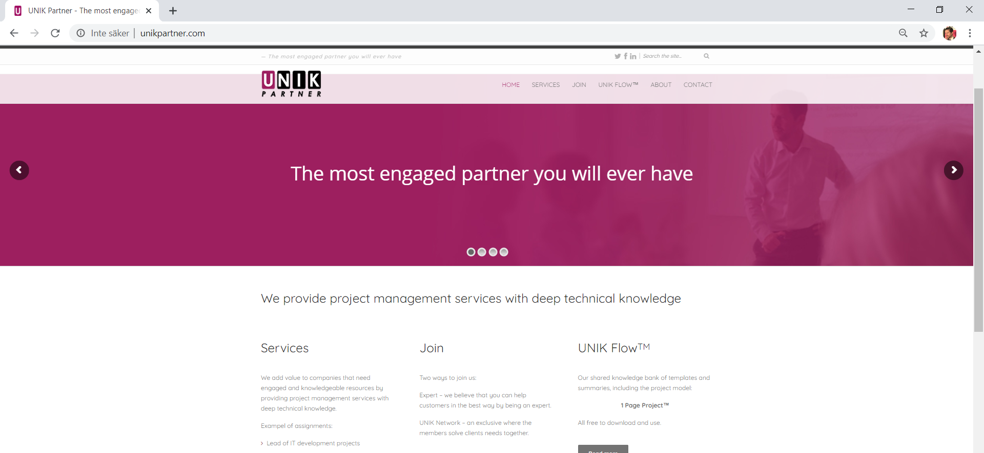
Implement the design
1
Welcome
Target group: all
Strategy: Create interest for all target groups
Call of action: Categorize yourself

